Slide 1
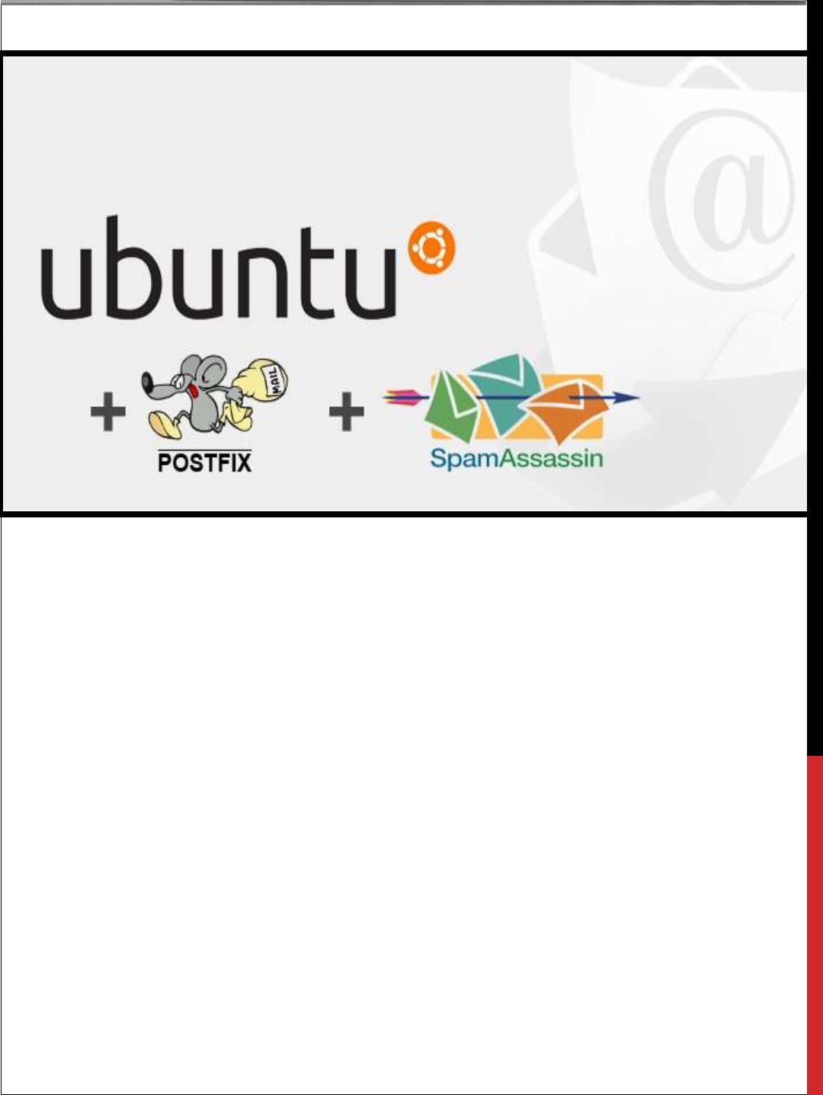
MAIL SERVER ON UBUNTU
POSTFIX, COURIER, SSL/TLS, SPAMASSASSIN,
CLAMAV, AMAVIS
Ritesh Agicha - 02
Jitesh Bhatia - 08
Sagar Bhojwani - 09

Slide 2
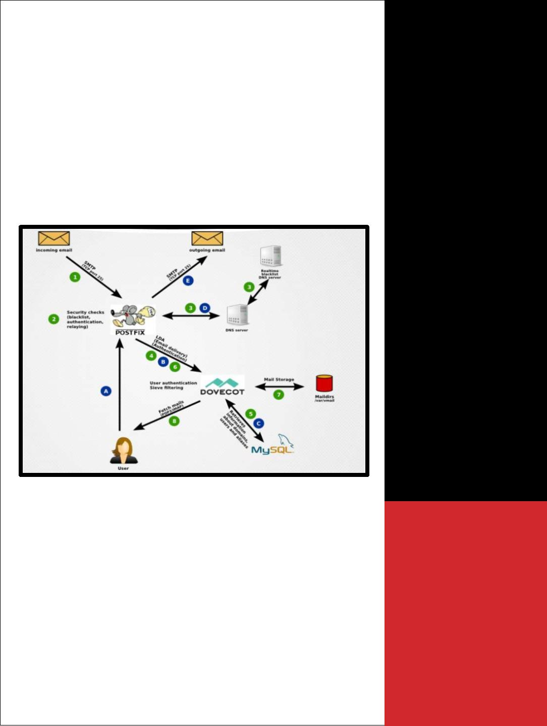
MAIL SERVER ON
UBUNTU
MDA
The MDA gets
messages from the
mail server into the
users' inboxes, most
commonly with the
POP or IMAP mail
protocols. Except
under some very
limited circumstances,
an MTA isn't going to
do you much good
without an MDA, so
we're going to be
using Dovecot as our
MDA.
POSTFIX, COURIER, SSL/TLS,
SPAMASSASSIN, CLAMAV, AMAVIS
INTRODUCTION
I. The green circles show what will happen when
you receive an email.
II. A remote mail server requests a TCP
connection on port 25 to your mail server.
Your
III. firewall lets that connection through and the
Postfix “smtpd” process will accept it.
IV. Postfix starts speaking SMTP (the “simple
mail
transfer
protocol”)
and
gathers
information who the alleged sender and the
intended recipient addresses are. While the

Slide 3

connection is still active Postfix does a couple of checks and may
decide to reject the email.
V. Postfix will also check real-time black lists (RBLs) via DNS to see if
the sending IP address should be distrusted. For example it will reject
senders running on a dynamic IP address because that almost always
means the email is coming from yet another infected Windows
workstation or hacked server and is likely spam.
VI. Postfix asks Dovecot whether the recipient email address belongs to
an actually known user.
VII. Dovecot checks the MySQL database and looks for an entry for the
email address in question.
VIII. If the user exists then Postfix will accept the email and forward it to
Dovecot.
IX. Dovecot stores the received email in a file in the /var/vmail directory.
X. The user fetches new email using the POP3 or IMAP protocols from
Dovecot.
XI. Now let’s assume the user replies to the email and wants to send the
reply. This is depicted by the blue circles.
(A) The user’s mail client establishes an SMTP connection to Postfix. It
sends a username and password to authenticate.
(B) Postfix asks Dovecot whether the username and password are correct.
This prevents accepting unauthorized email from untrusted parties.
(C) Dovecot searches for the account information of the sending user in the
MySQL database. It tells Postfix whether the authentication was
successful.
(D) Postfix needs to find out which server on the internet the email needs to
be sent to. It asks a DNS (domain name service) server for an MX (mail
exchanger) record of the receiving domain. If successful it will get the
name of the server back and will know where to send the email.
(E) Postfix connects to the responsible server of the receiving user,
establishes an SMTP connection and sends the email.
That much for a general overview.

Slide 4

SPAM ASSASSIN
• Spam assassin runs sanity checks on an incoming mail to determine how
likely it is to be spam
• It is a computer program used for email spam filtering. It uses a variety of
spam detection techniques including DNS based, checksum based spam
detection, regular expressions, pattern matching techniques etc.
• The program can be integrated with the mail server to automatically filter
all mail for a site.
• Spam assassin is a highly configurable; if it is used as a system wide
filter can still be configured to support per user preferences.
CLAMAV
Clam Antivirus is a free and open source, cross platform antivirus software
toolkit available to detect many types of malicious software and viruses.
• One of its main use is it is used on mail servers as server side email virus
scanner.
• Clam AV includes a number of utilities such as command line scanner
Automatic database updater and scalable multithreaded daemon, running
on antivirus engine from a shared library.
• Clam AV database is updated at least every 4 hours.
AMAVIS
• Amavis is an open source content filter for electronic mail used for
message transfer, decoding and some other processing and checking and
interfacing with external content filter to provide protection against spam,
viruses and other malwares.
• It can be considered as an interface between a mailer and one or more
content filters.

Slide 5
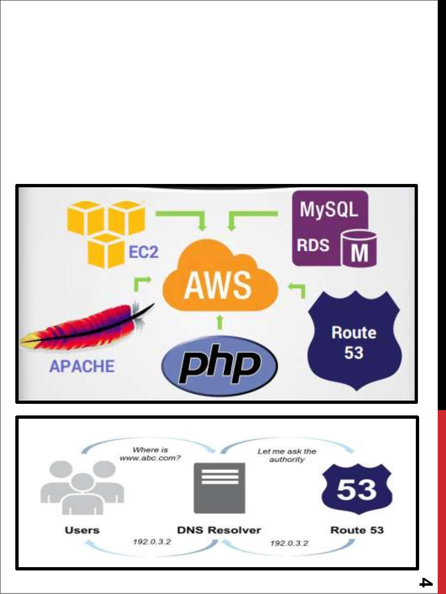
• Amavis can be used for detecting viruses, spams, banned content types,
syntax errors etc.
• It can be used for redirect or forward of emails, it can be used for
archiving of mail messages to files, to mailboxes, to an SQL database.
• It is used to sanitize passed messages through external sanitizer
• It can be further interfaced with spam assassin to provide reliability,
security, performance.
HOSTING

